Slide 1


Java Programme
Presented by: Monde Nkuna
Date: 23/01/2024

Slide 2

Introduction
Overview
The programme
Benefits in industry

Slide 3

Agenda
Problem Statement
Solution
Other Options
Decisions
Conclusion & Recommendations

Slide 4

Problem statement
Lack of Data
Non efficiency
Admin issues

Slide 5
Solution
Automation
Method used on Code
Reliability

Slide 6
Solution
Challenge1Main

Slide 7
Solution
Challenge1Main
Prompter

Slide 8
Solution
Challenge1Main
Prompter
Validator
DateValidator
NumberValidator

Slide 9
Solution
Challenge1Main
Prompter
Validator
Calculator
DateValidator
NumberValidator
AgeCalculator
MilesCalculator

Slide 10
Solution
Challenge1Main
Prompter
Printer
Validator
Calculator
DateValidator
NumberValidator
AgeCalculator
MilesCalculator

Slide 11
Other Options
Object Oriented
Inheritance
Monoliths
Iterate through loops

Slide 12
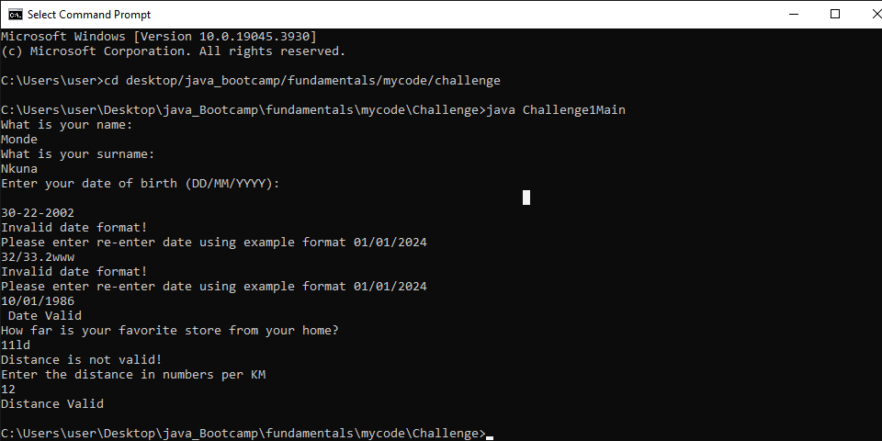
Other Options
Iterate through loops

Slide 13
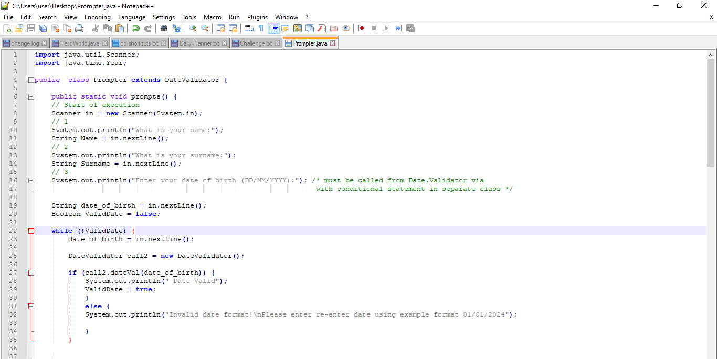
Other Options
Class Inheritance

Slide 14

Decisions
Best Practices
Use of Static instead of Inheritance
Code writing
Decoupling methods
End user

Slide 15

Conclusion and recommendations
Overall
best use
what to improve
Considerations

